Slide 1

Capstone: Attribution
Learn SQL from Scratch
Natalie Cabayan
07/10/2018

Slide 2
Get Familiar With the Company

Slide 3
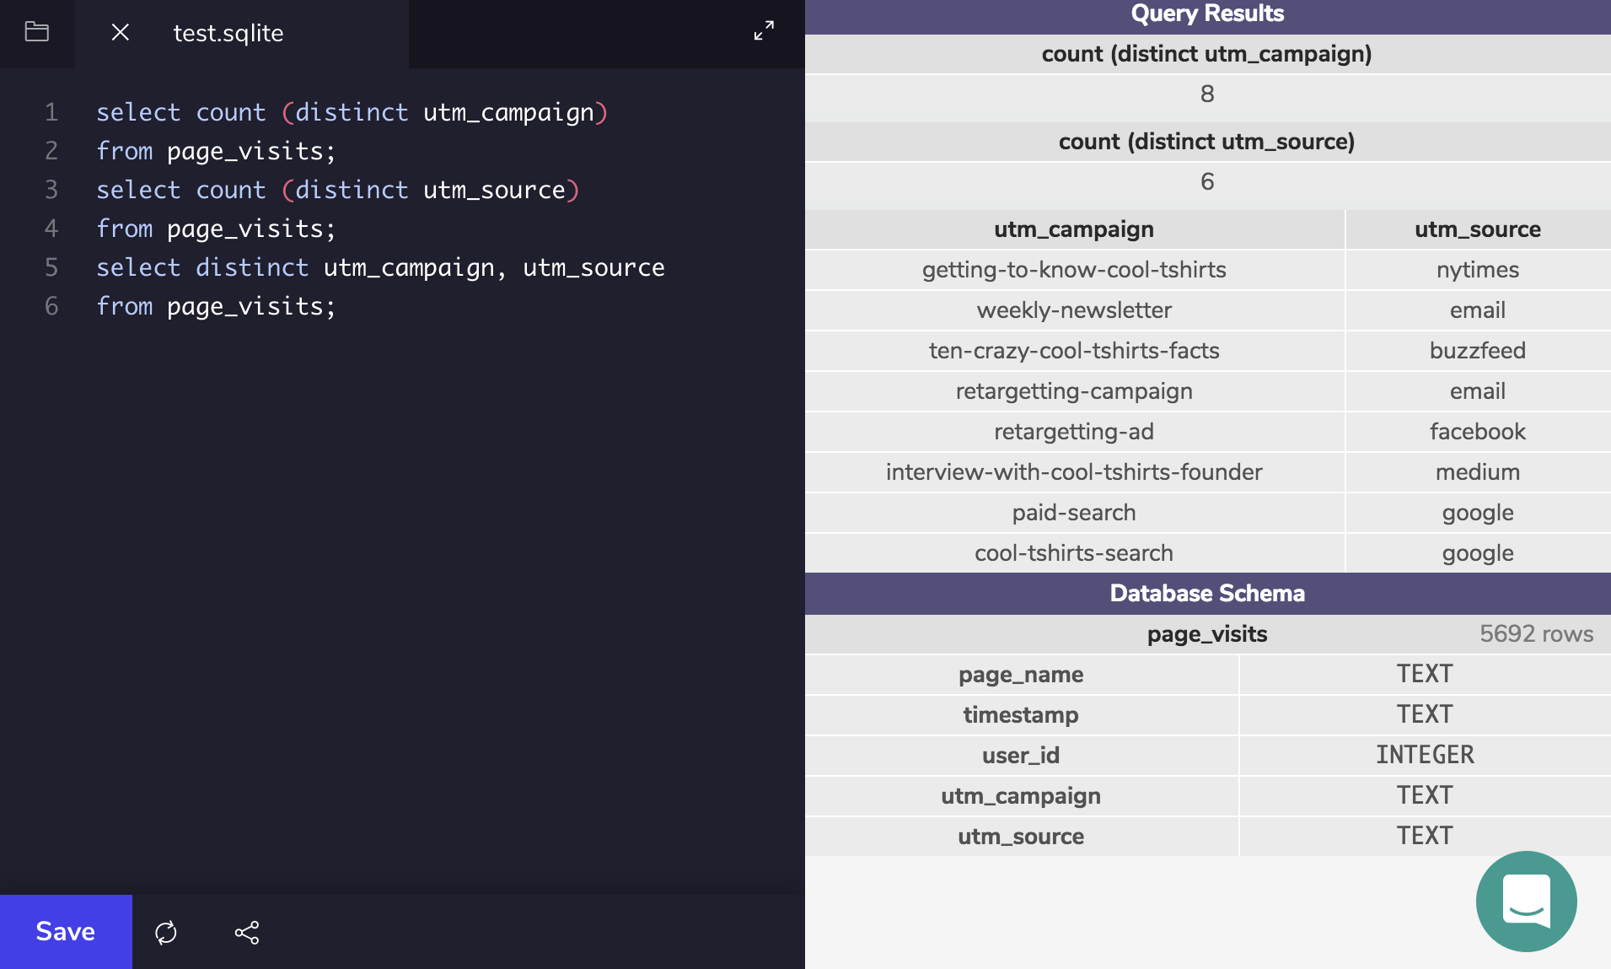
Question
Number 1
Answer
Number 1
1. How many campaigns and sources does CoolTShirts use? Which source is used for each campaign?
Use three queries:
one for the number of distinct campaigns,
one for the number of distinct sources,
one to find how they are related.

Slide 4
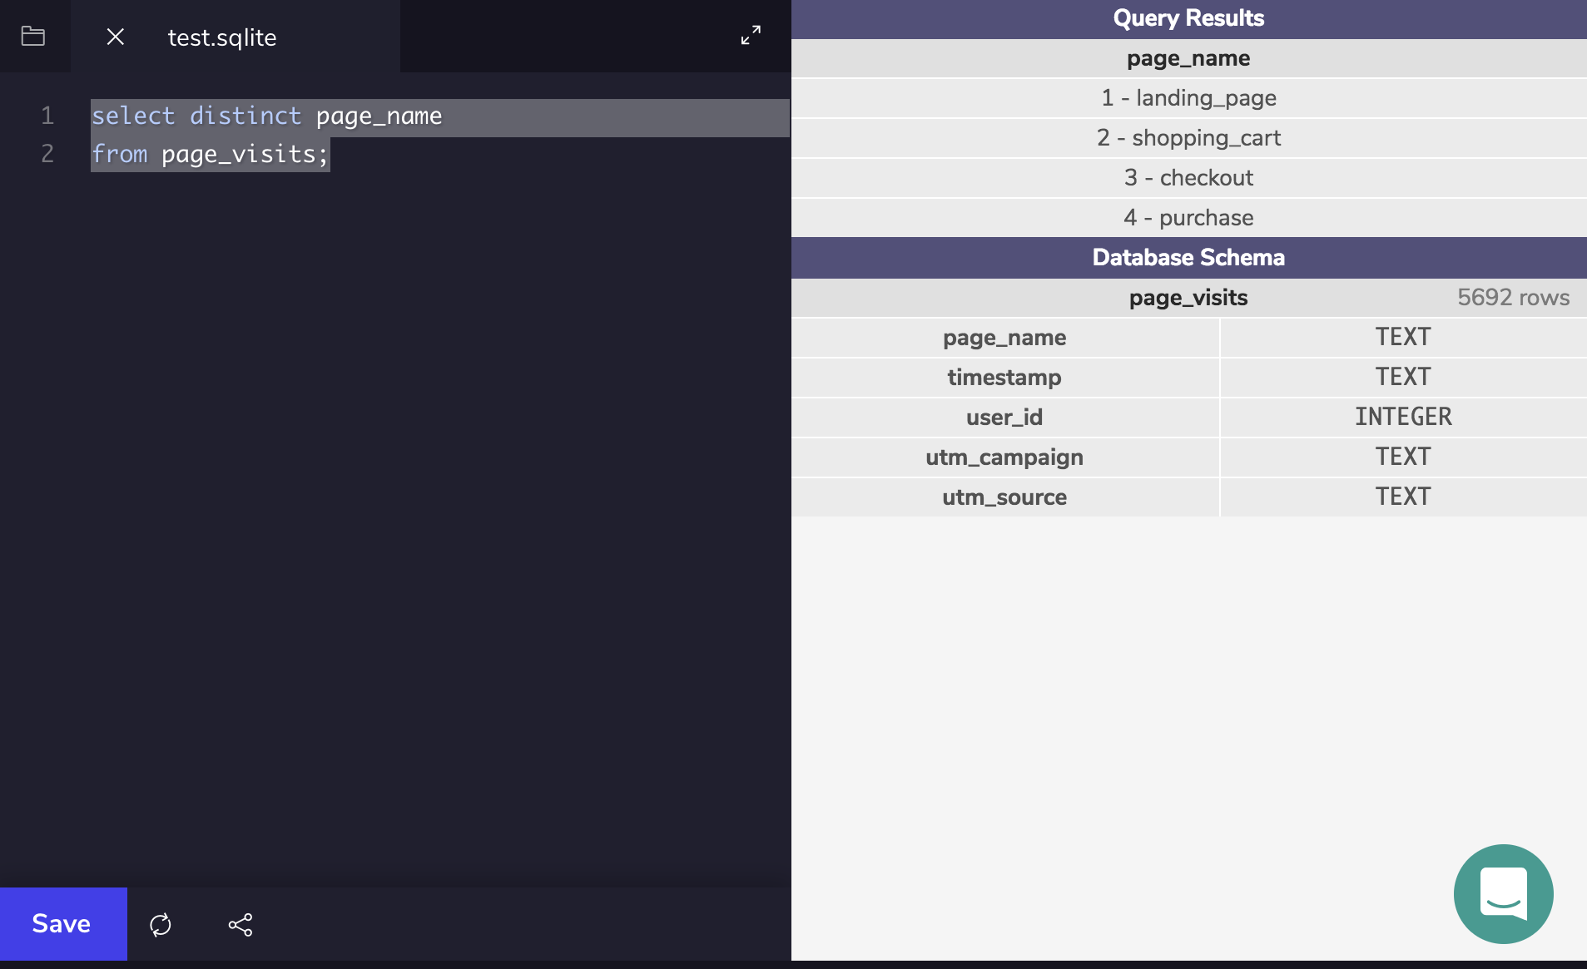
Question
Number 2
Answer
Number 2
What pages are on the CoolTShirts website?
Find the distinct values of the page_name column.

Slide 5
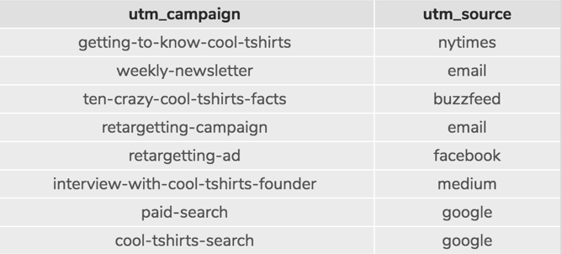
Get Familiar With the Company – Explanation
CoolTShirts is currently using 8 distinct campaigns and 6 distinct sources. The website for CoolTShirts has 4 pages which include the landing page, the shopping cart, the checkout page and the purchase page.
Each campaign within CoolTShirts is tied to a source. Please see below for a list of all the campaigns as well as the affiliated source for that campaign.

Slide 6
What is the User Journey?

Slide 7
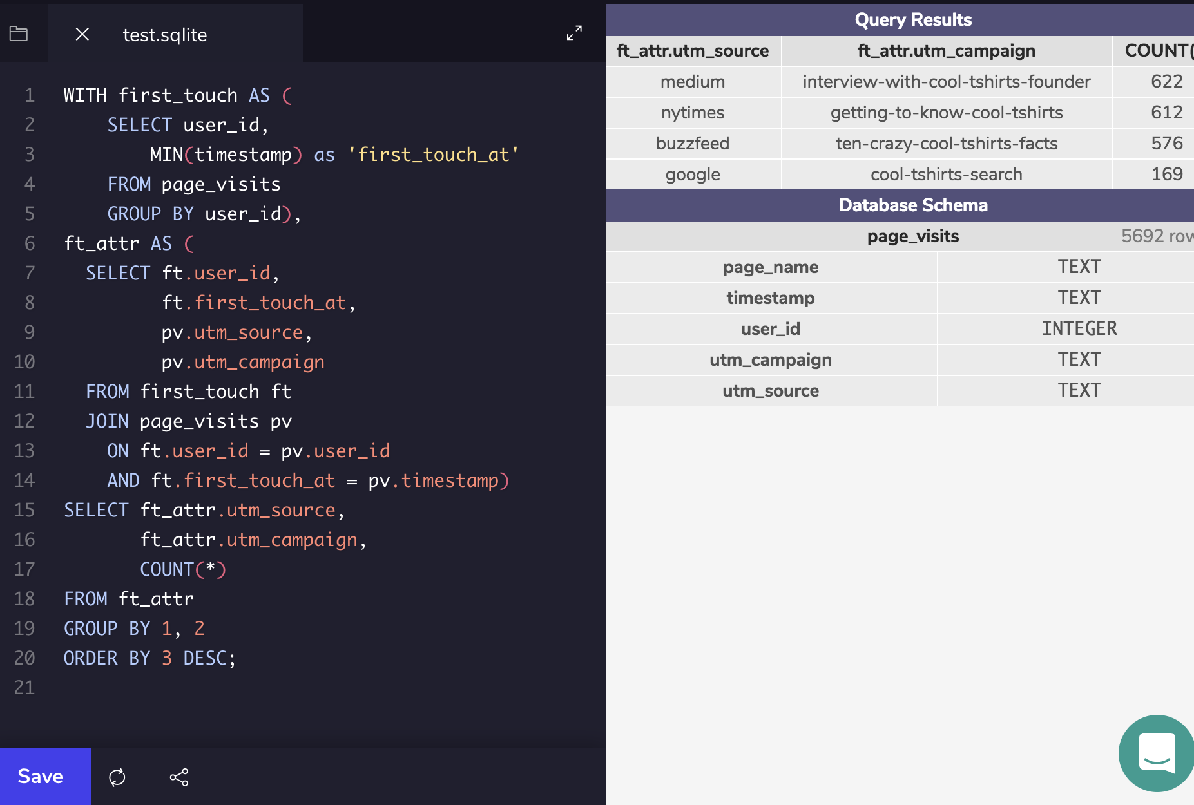
Question
Number 3
Answer
Number 3
How many first touches is each campaign responsible for?
You'll need to use the first-touch query from the lesson (also provided in the hint below). Group by campaign and count the number of first touches for each.

Slide 8
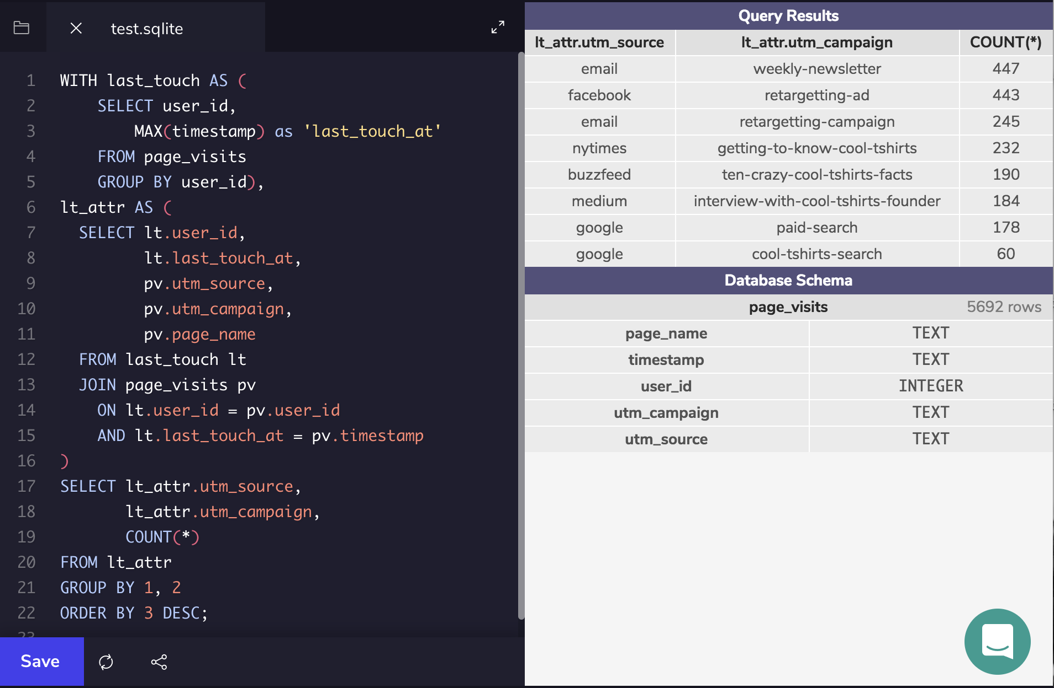
Question
Number 4
Answer
Number 4
How many last touches is each campaign responsible for?
Starting with the last-touch query from the lesson, group by campaign and count the number of last touches for each.

Slide 9
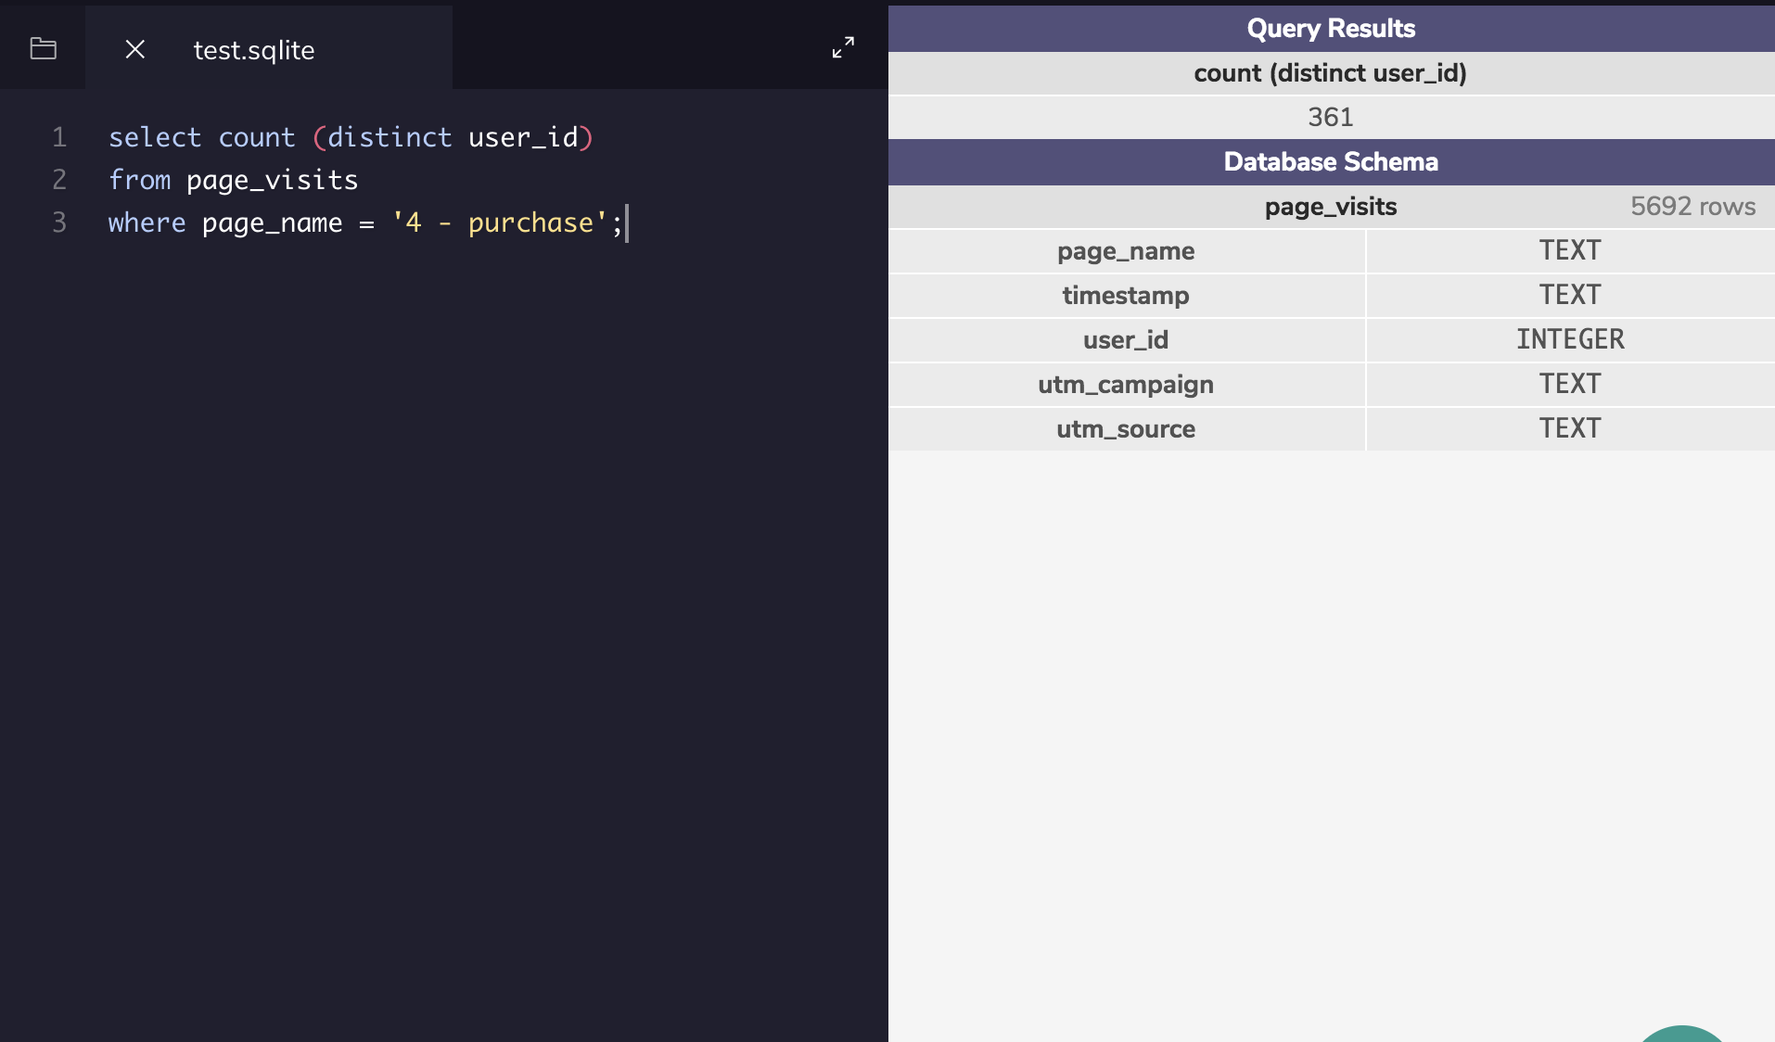
Question
Number 5
Answer
Number 5
How many visitors make a purchase?
Count the distinct users who visited the page named 4 - purchase.

Slide 10
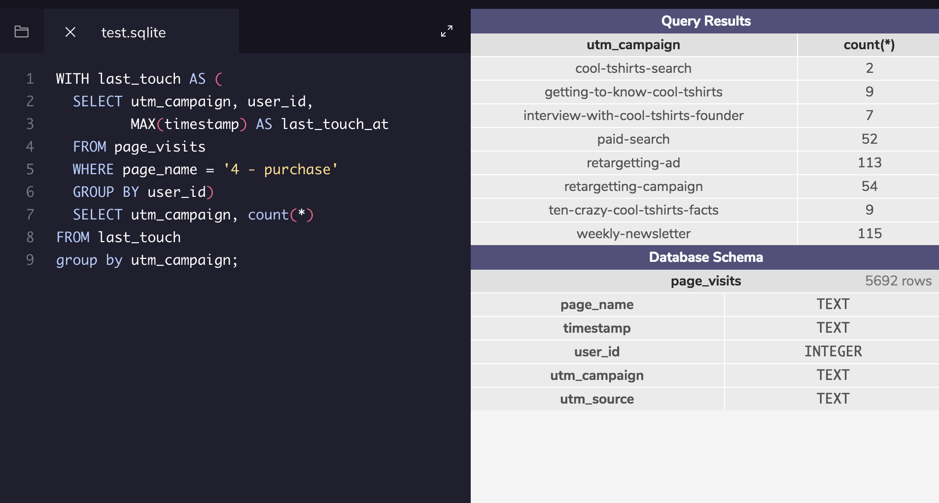
Question
Number 6
Answer
Number 6
How many last touches on the purchase page is each campaign responsible for?
This query will look similar to your last-touch query, but with an additional WHEREclause.

Slide 11
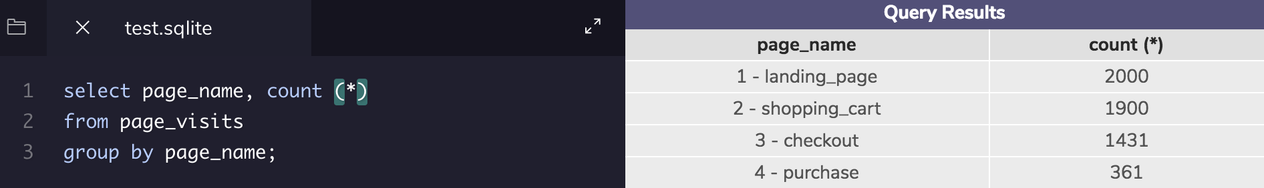
What is the typical user journey?
The majority of users come through the source called Medium followed by NY Times, Buzzfeed and Google in descending order. Emailed weekly newsletters have the highest last touch metrics. When running a code to see the drop off rate between each interaction you will see the following:

Slide 12
Optimize the Campaign Budget

Slide 13
CoolTShirts can re-invest in 5 campaigns. Which should they pick and why?
If CoolTShirts wanted to re-invest in 5 Campaigns they should pick the following in descending order:
Weekly Newsletter
Retargeting-ad
Retargeting Campaign
Paid Search
Ten-Crazy Cool T-Shirts
The reason for the top 4 is because they have the highest numbers of last touches on the purchase page. The fifth top for last touch being the purchase page was tied so I compared it to the chart that shows how many last touches each campaign is responsible for. Ten-Crazy Cool T-shirts was responsible for less last touches than Getting-to-know-CoolTShirts. At the end of the day its better for the site to promote campaigns that not only lead to the purchase page but also lead to the fewest amount of last touch points excluding the purchase page as we at least want people to continue to navigate the site if they don’t purchase anything.

